Slide 1

MINI PROJECT ON: CHAT SEMENTIC ANALYZER V-SEM
Submitted by: Harshit narang UNIVERSITY ROLL NO :2011076
SEC : B SESSION:2022-2023

Slide 2

OBJECTIVE :
Semantic analysis starts with lexical semantics, which studies individual words’ meanings (i.e., dictionary definitions). Semantic analysis then examines relationships between individual words and analyzes the meaning of words that come together to form a sentence.
This analysis provides a clear understanding of words in context.

Slide 3
MOTIVATIO:
Semantic analysis is key to contextualization that helps disambiguate language data so text-based NLP applications can be more accurate.
Exploring new things and filling up curiosity about NLP that are very important in our day-to-day life.
The goal of Sentiment Analysis is to harness this data in order to obtain important information regarding public opinion, that would help make smarter business decisions, political campaigns and better product consumption

Slide 4
METHODOLOGY :
Methodology was divided in two parts that are:
DATA ANALYSIS: It is a process of cleaning, transforming, inspecting and modelling data with the goal of discovering some useful information and finally indicating some conclusions..
PROPOSED SYSTEM: Data pre-processing is the initial part of the project; it is to understand the implementation and usage of various python inbuilt modules. These various modules provide better user understandability and code representation.

Slide 5
TOOlS USED :
Following tools were used to make this project:
Pycharm which is being used to implement the source code .

Slide 6
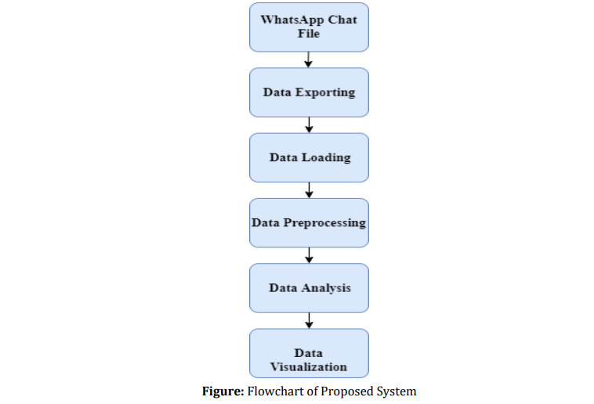
WORKING :

Slide 7
APPROACH :
Learning the concept behind the project
Making a roadmap on the demonstration of the project.
Deciding a language to demonstrate the project here is python.
Testing the project on sample text files.
Modify changes accordingly.

Slide 8

REAL WORLD APPLICATION :
Customers contact businesses through multiple channels, and it can be hard for teams to stay on top of all this incoming data.
With sentiment analysis tools, however, we can automatically sort our data as and when it filters into your help desk. Let’s take a look at the most popular applications of sentiment analysis:
Social Media Monitoring
Customer Support Ticket Analysis
Brand Monitoring and Reputation Management
Listen to voice of the customer
Listen to voice of the employee
Product Analysis
Market Research and Competitive Research

